Slide 1
TCP Servers
bufio Scanners, strings.Fields, concurrency

Slide 2
but first, a review

Slide 3
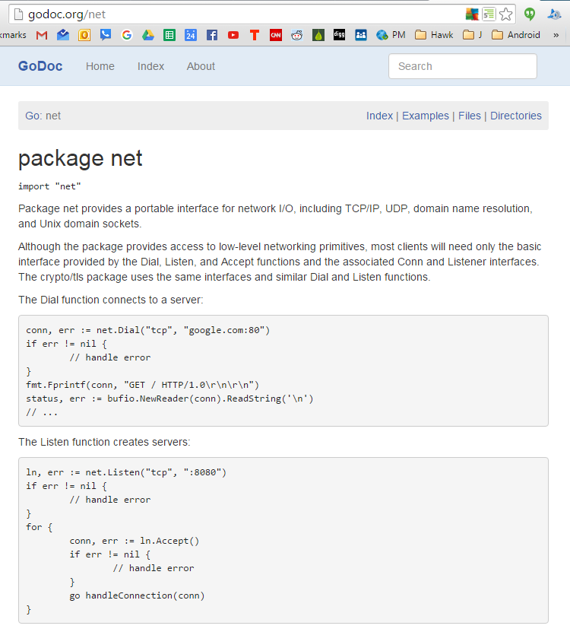

Slide 4
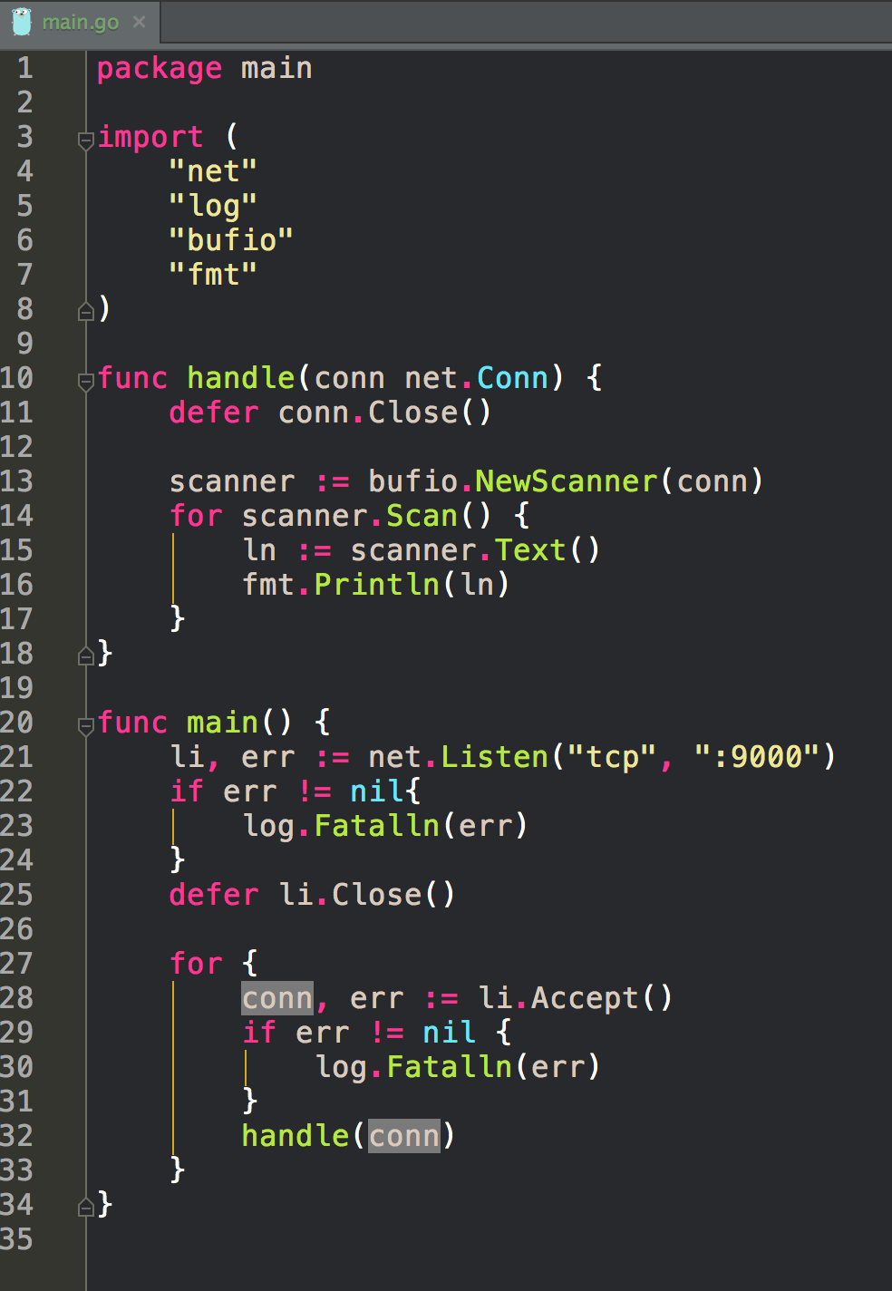
What will this code do?

Slide 5
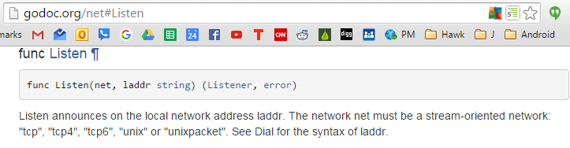
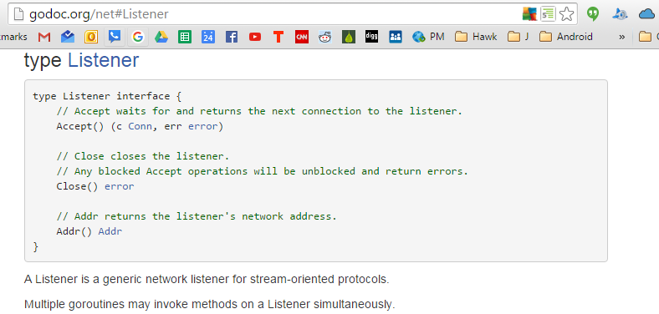

Slide 6
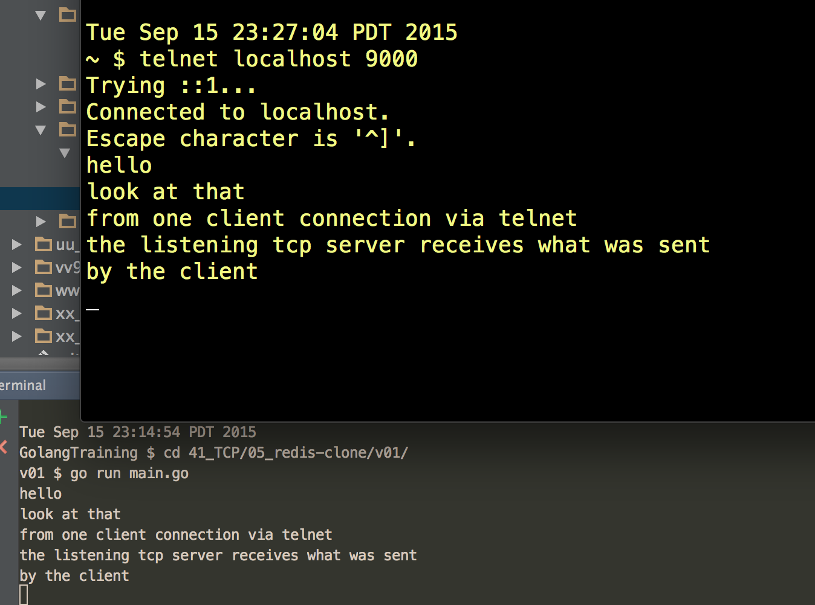

Slide 7
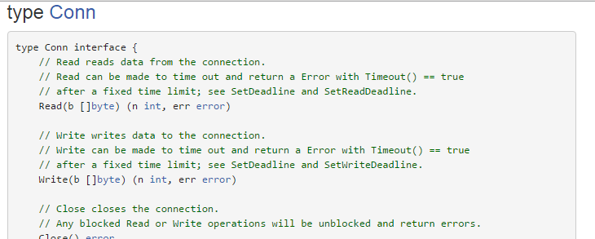

Slide 8
package bufio

Slide 9
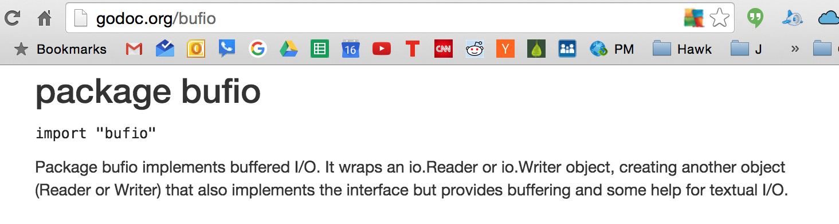

Slide 10
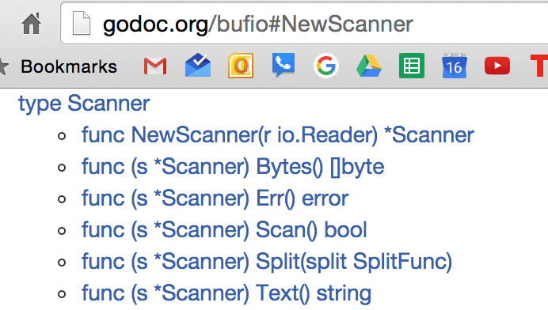

Slide 11
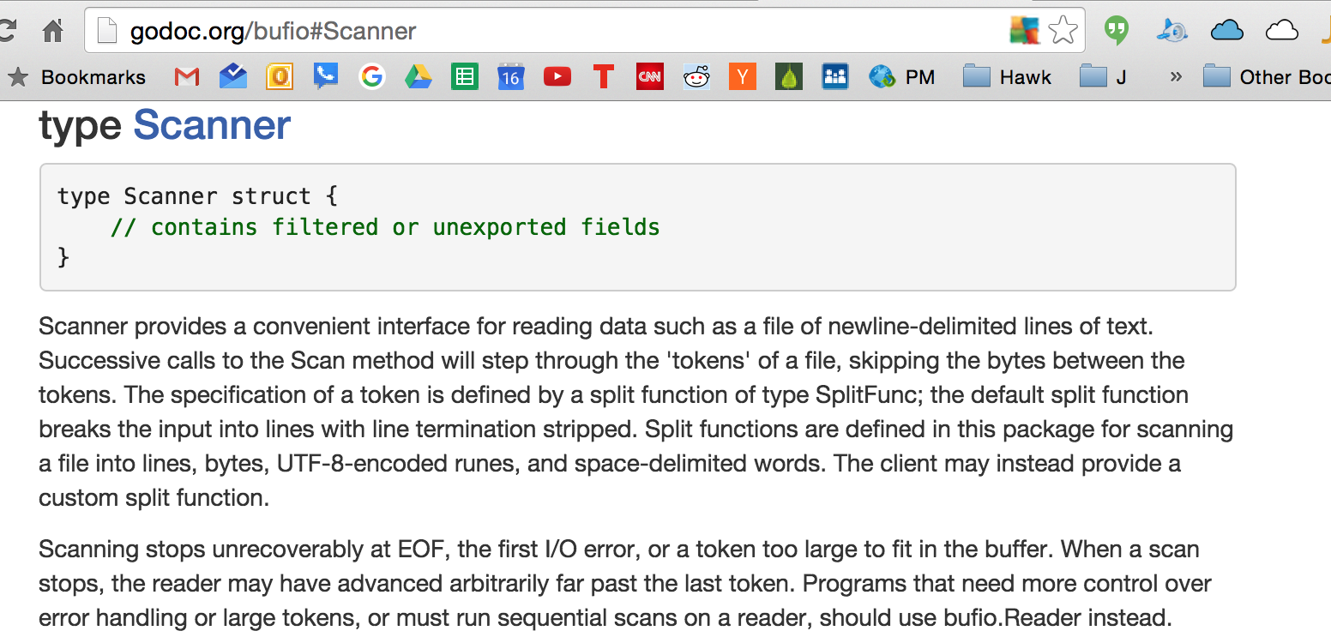

Slide 12
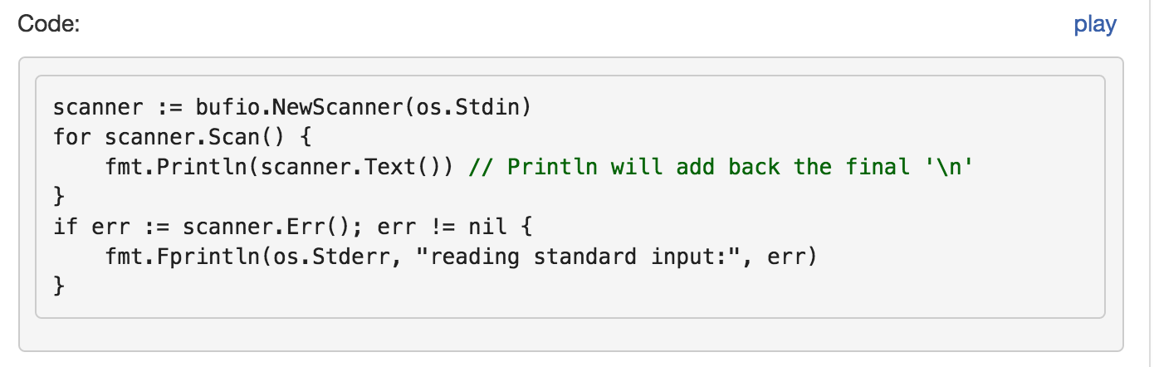

Slide 13
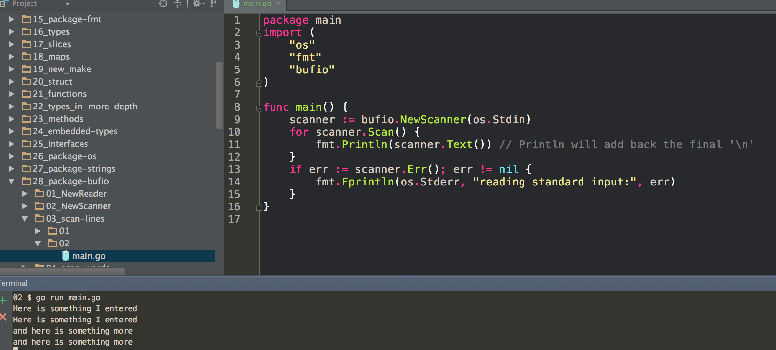

Slide 14
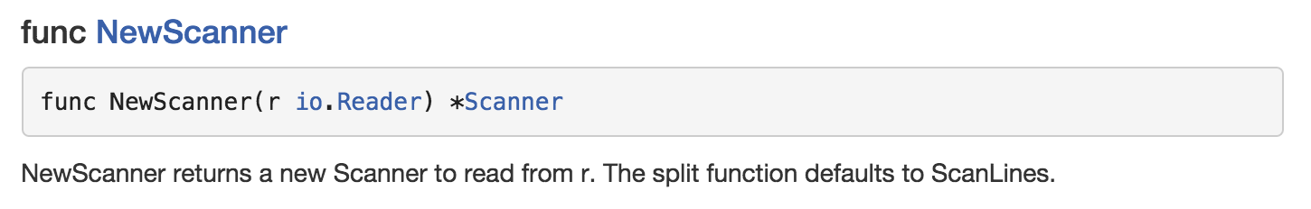
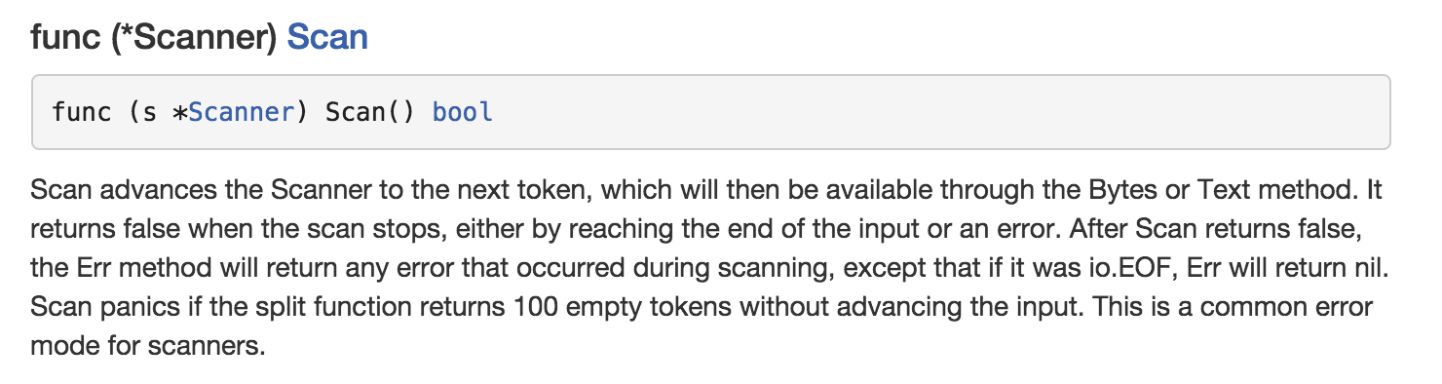
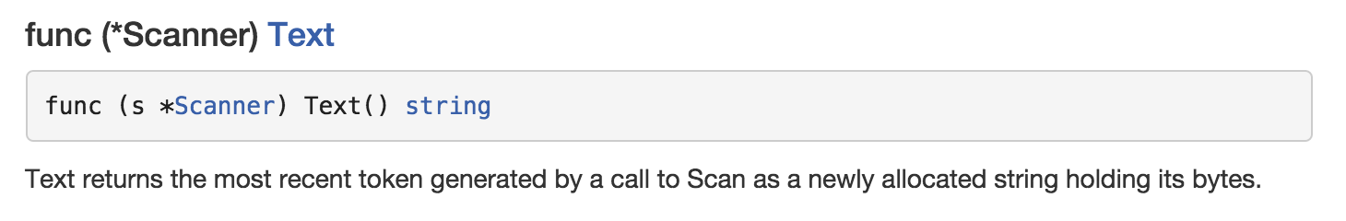

Slide 15
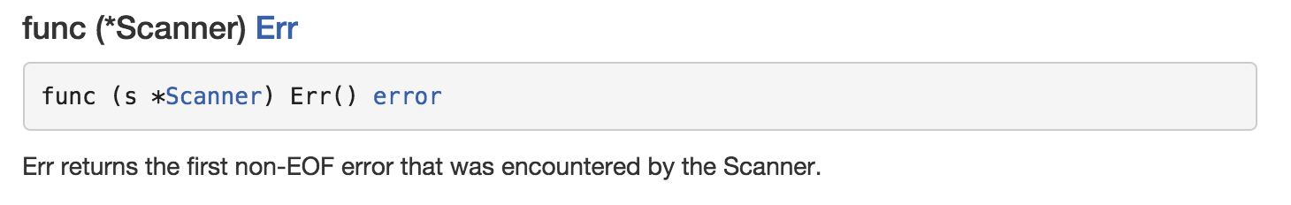

Slide 16
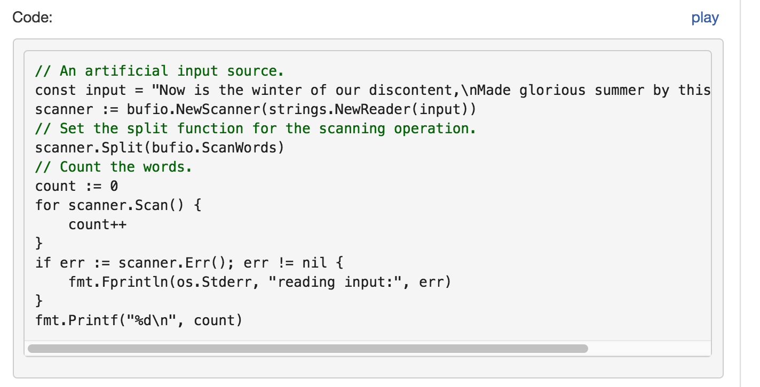

Slide 17
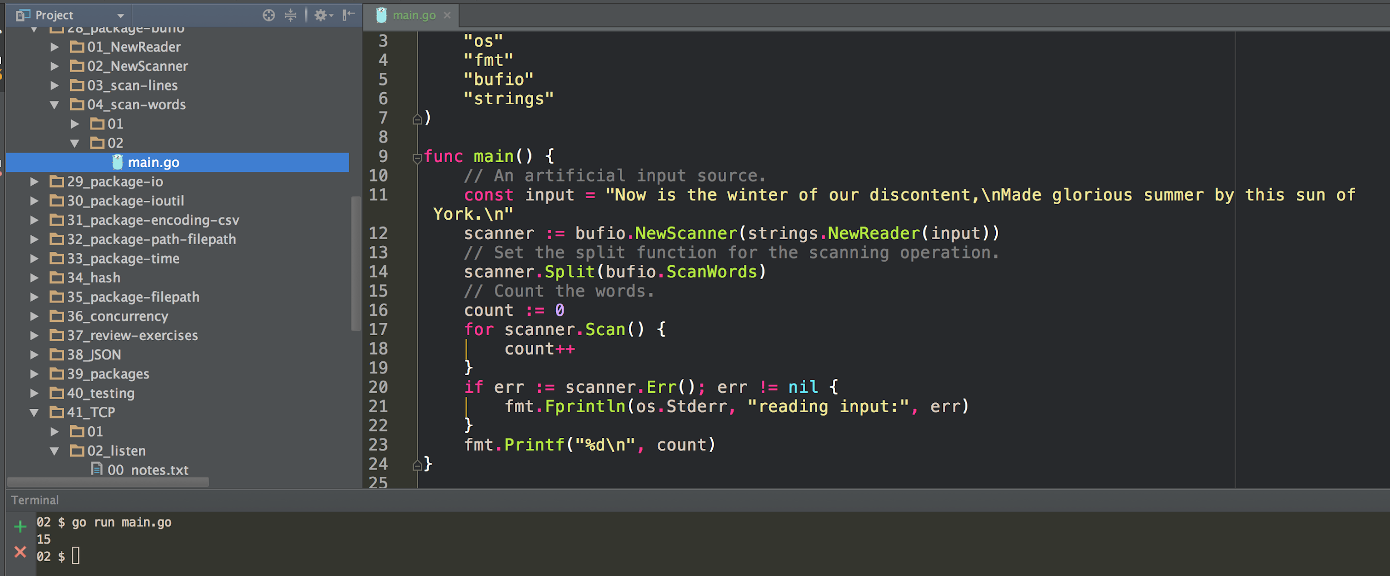

Slide 18
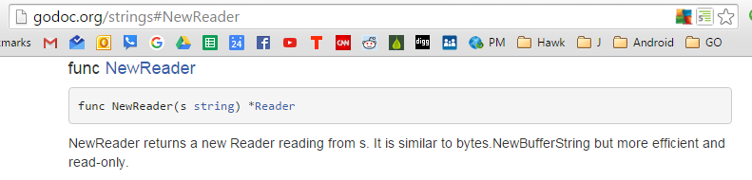
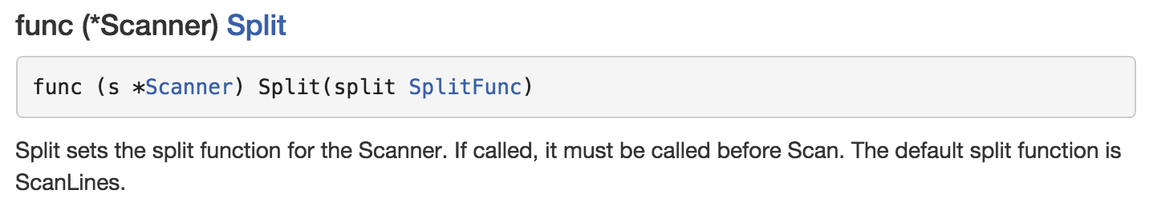
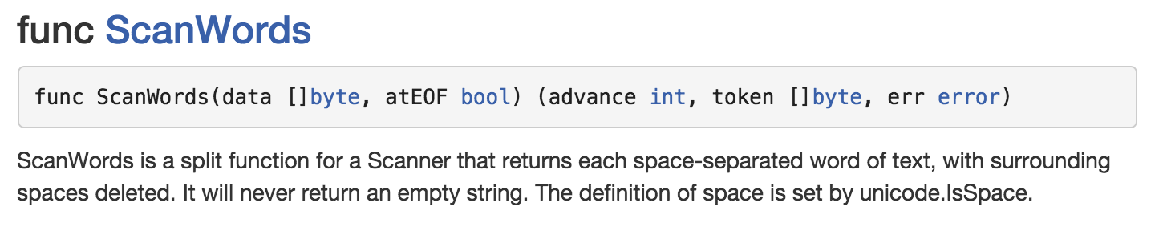

Slide 19
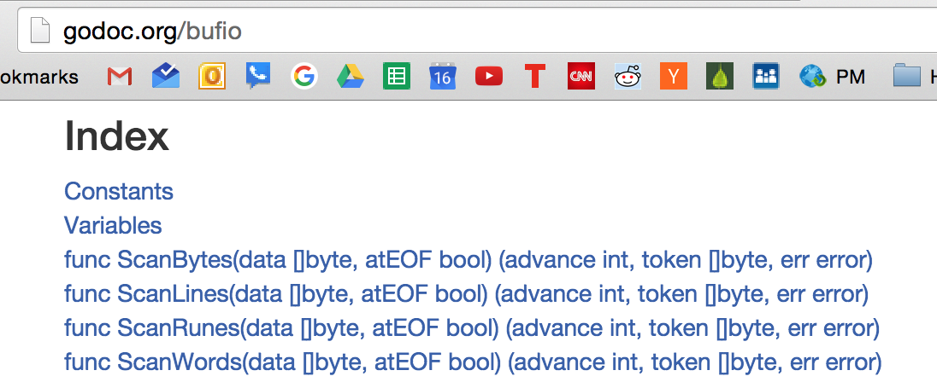

Slide 20
How would we change this code to print each word?

Slide 21
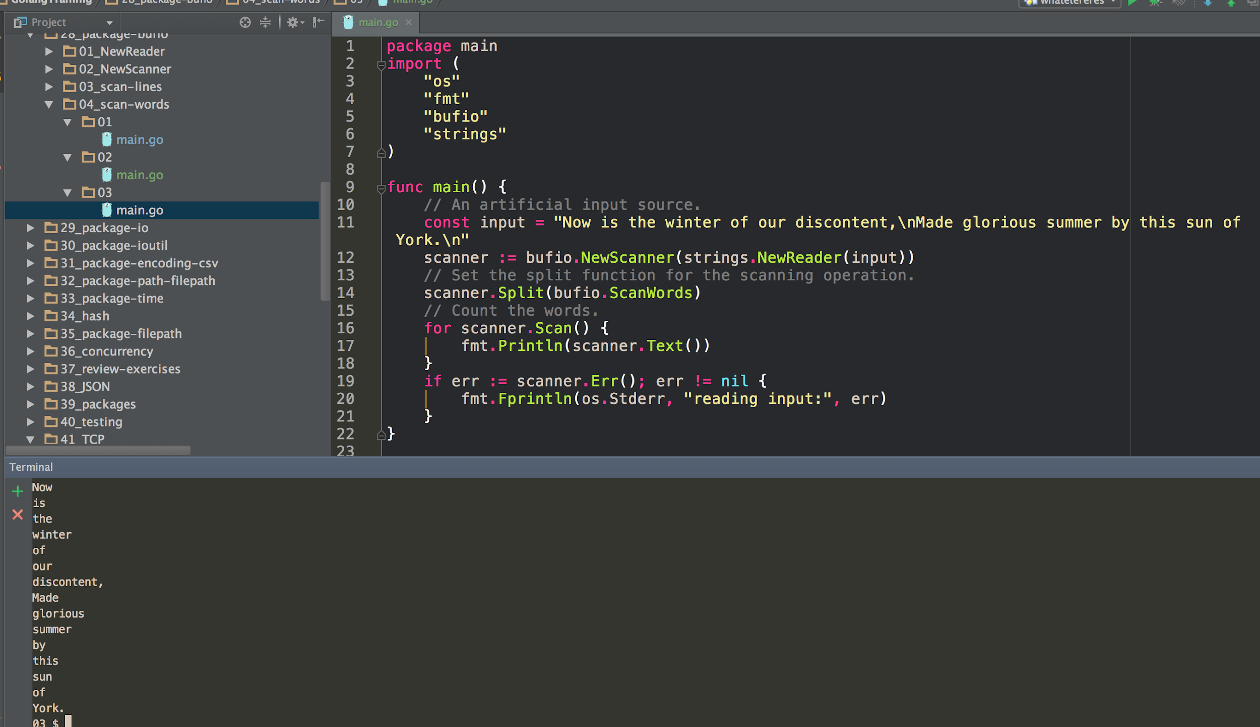

Slide 23
Show of hands:
Does this code make more sense now that we’ve talked about scanners?

Slide 24
exercise
Create a simplified redis clone which accepts GET, SET and DEL commands. ‘GET <KEY>’ should write the value of <KEY> followed by a new line. ‘SET <KEY> <VALUE>’ should set the value of <KEY>. ‘DEL <KEY>’ should remove the value. Data should be stored in memory.

Slide 25
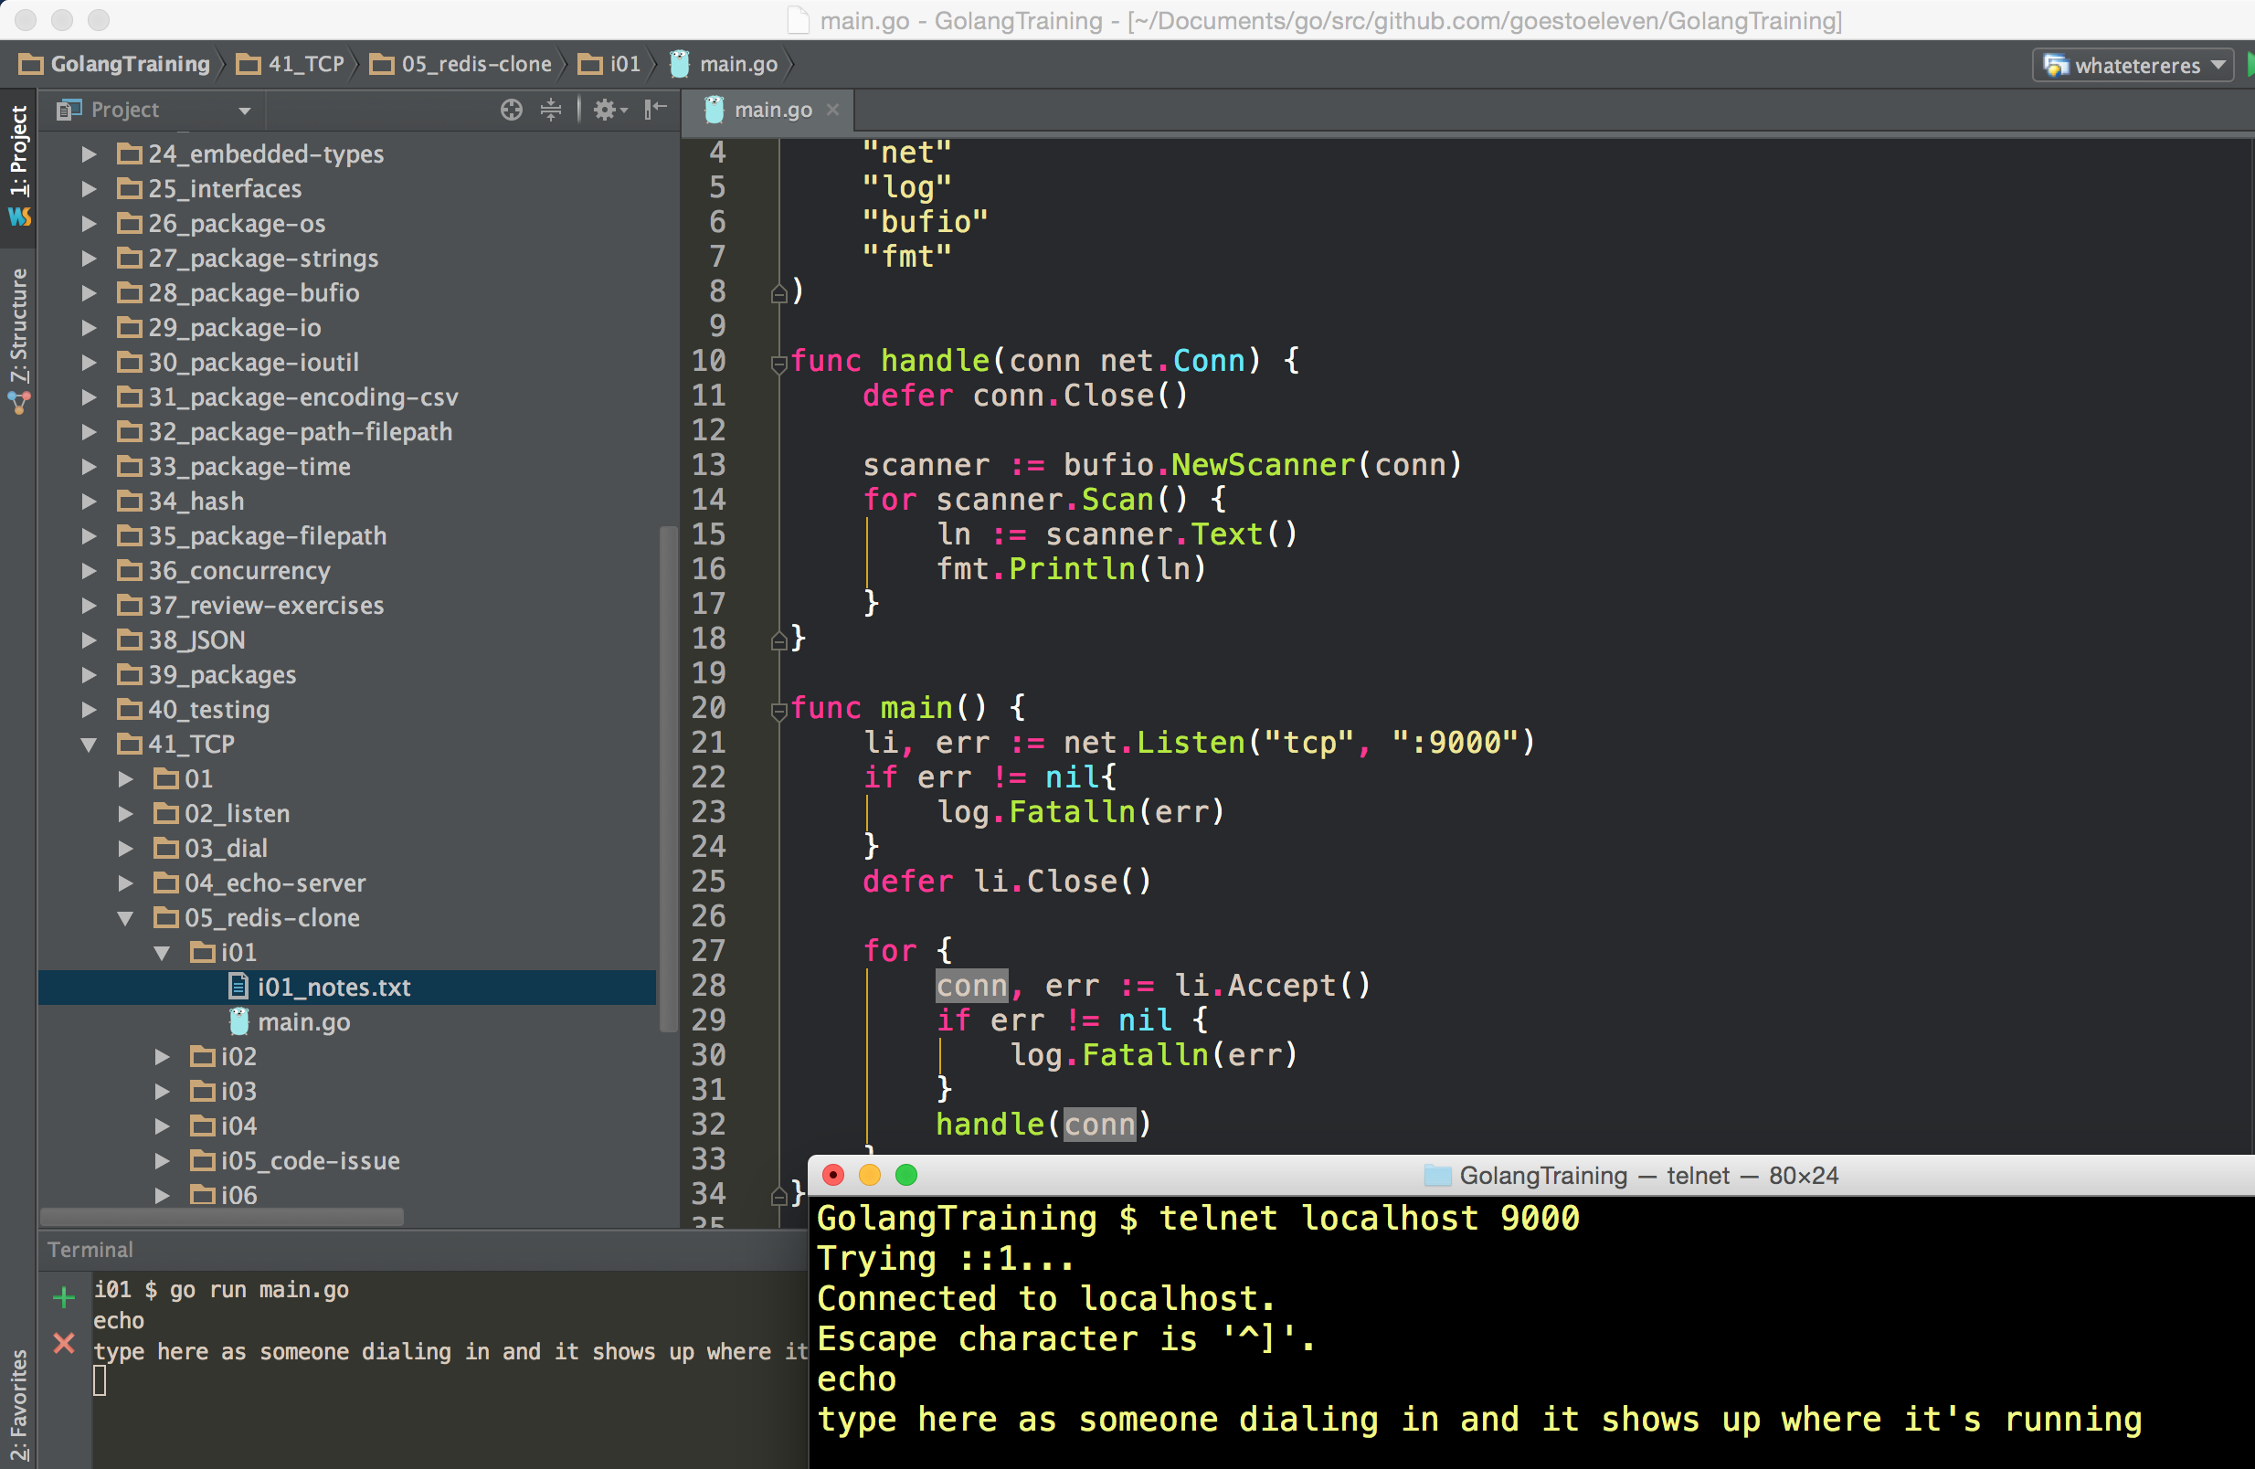

Slide 26
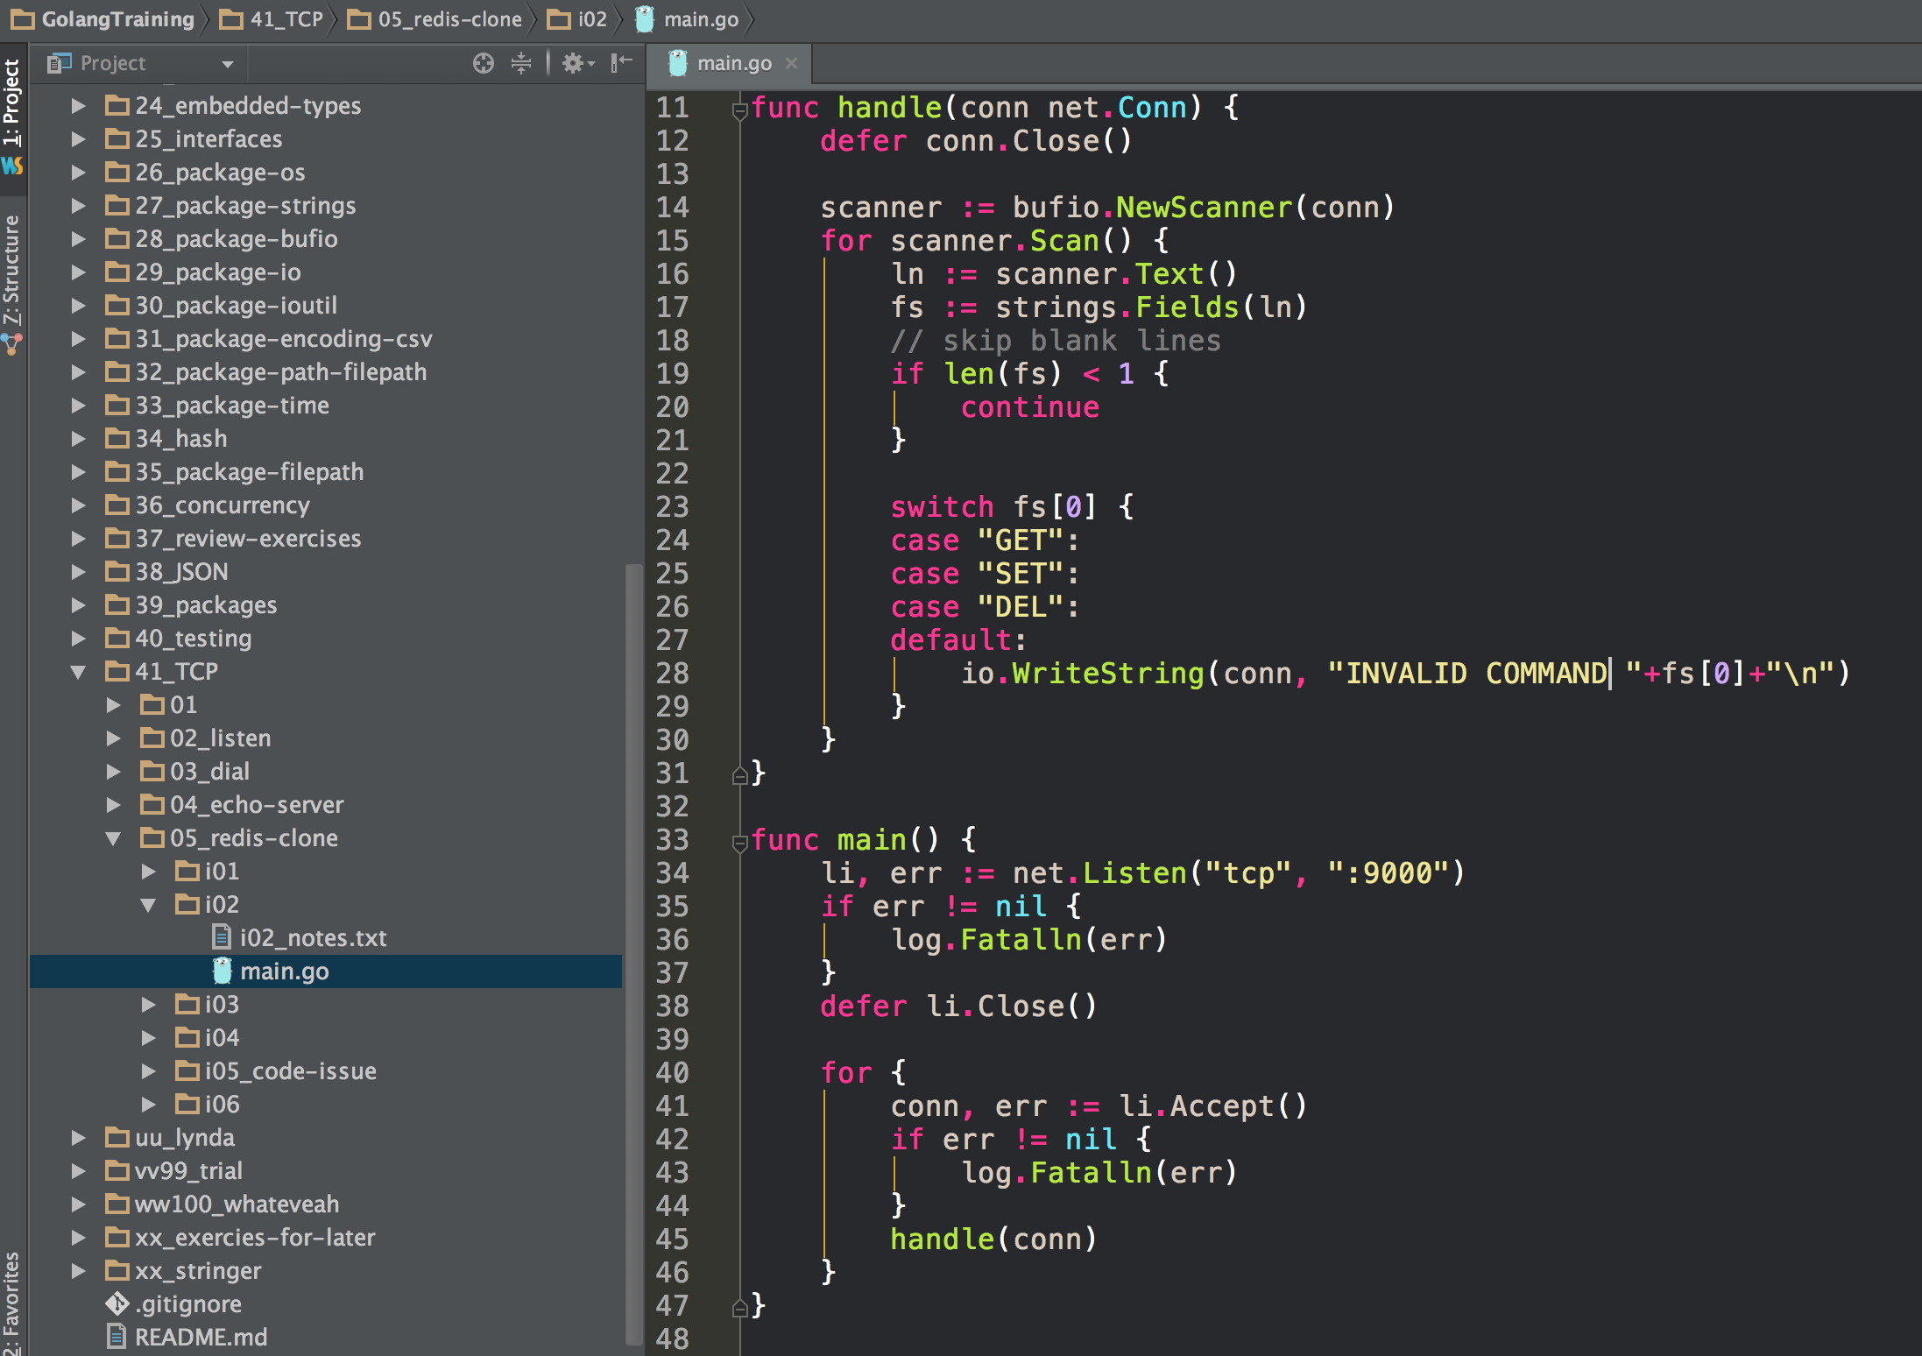
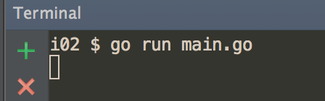
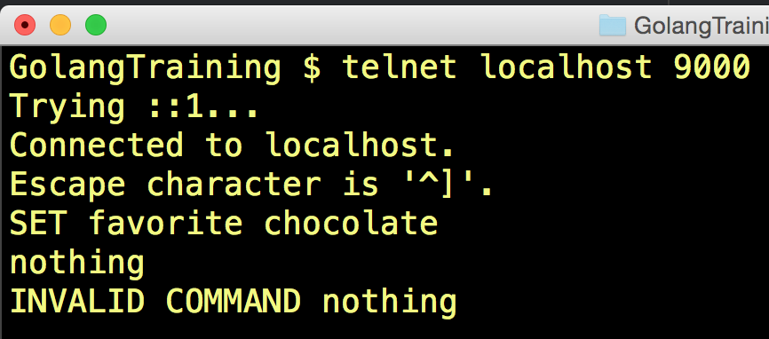

Slide 27
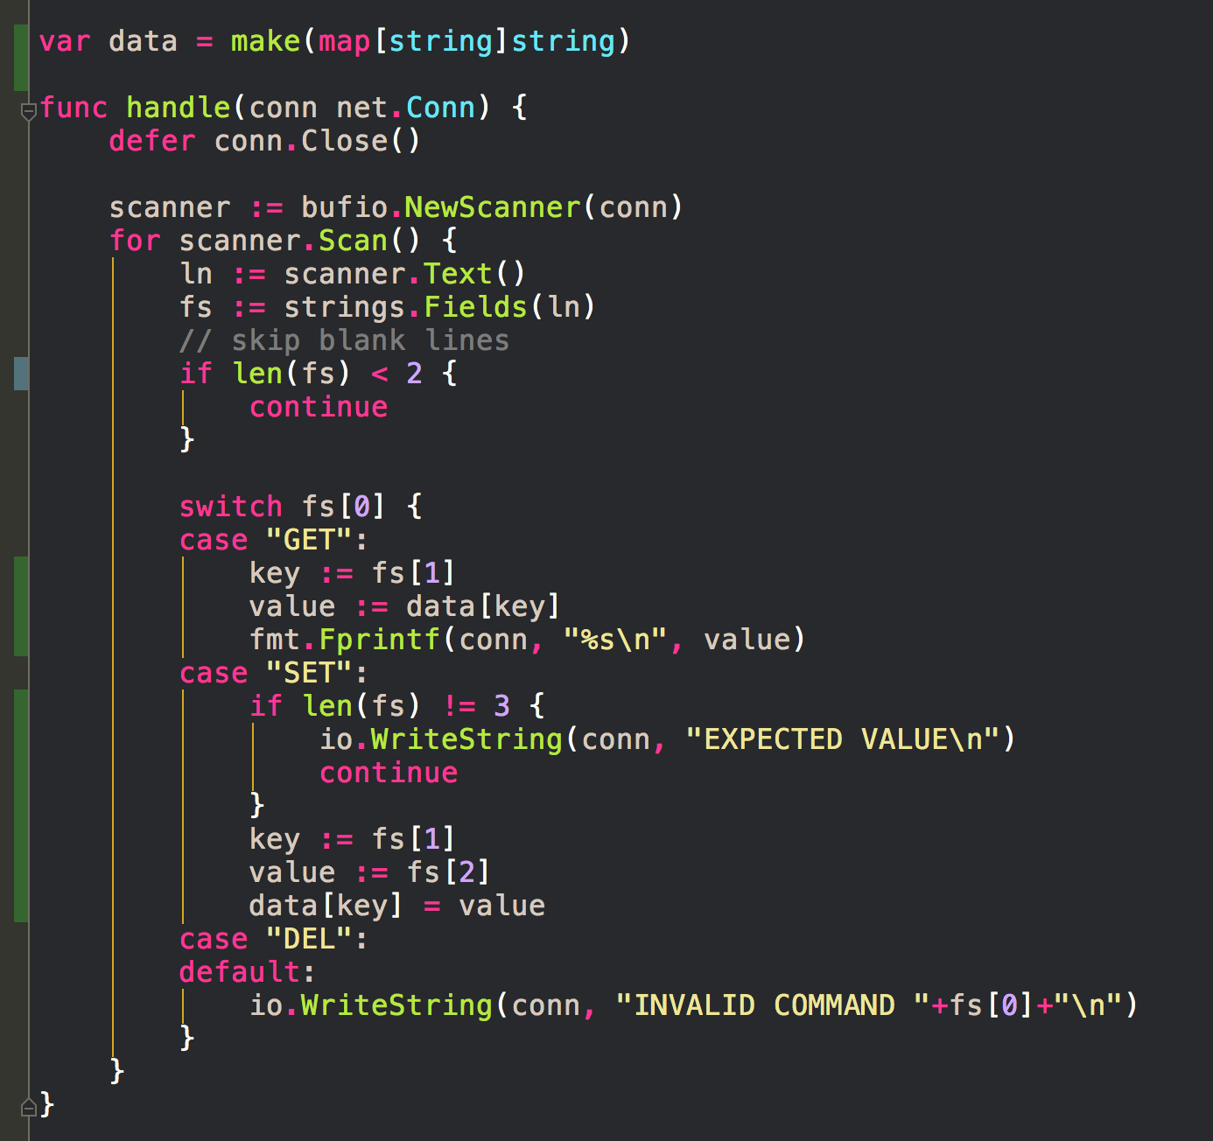
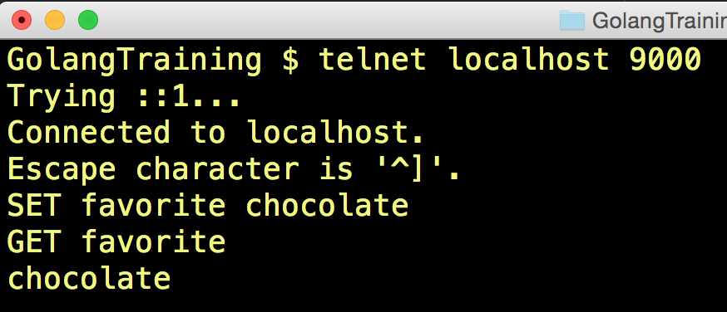

Slide 28
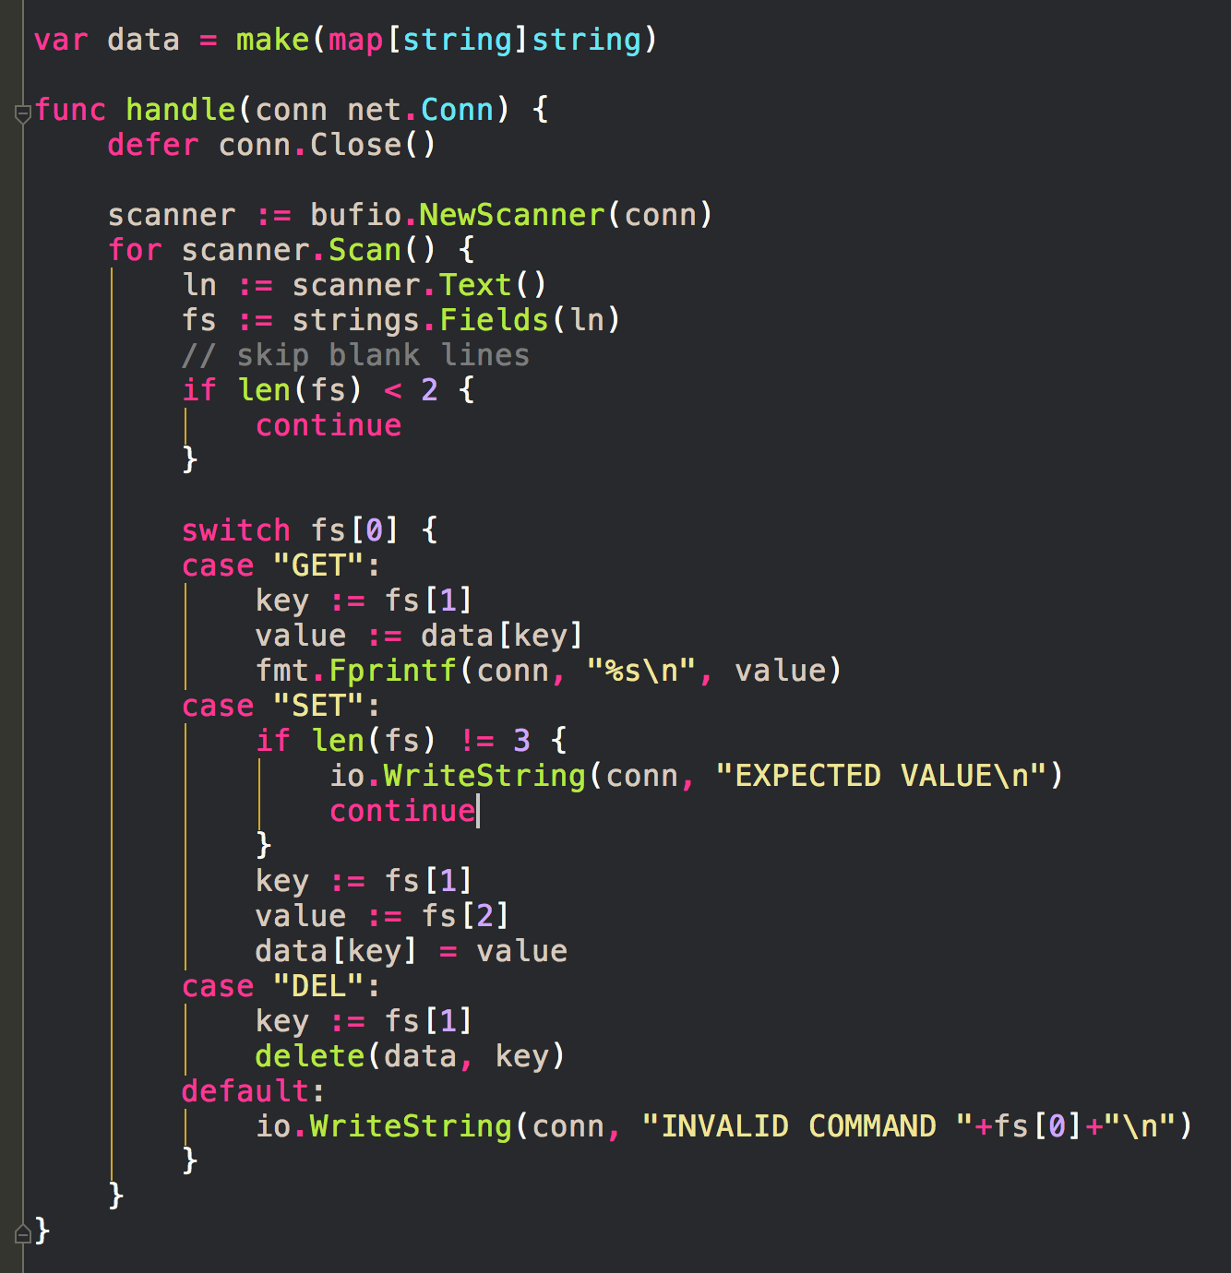
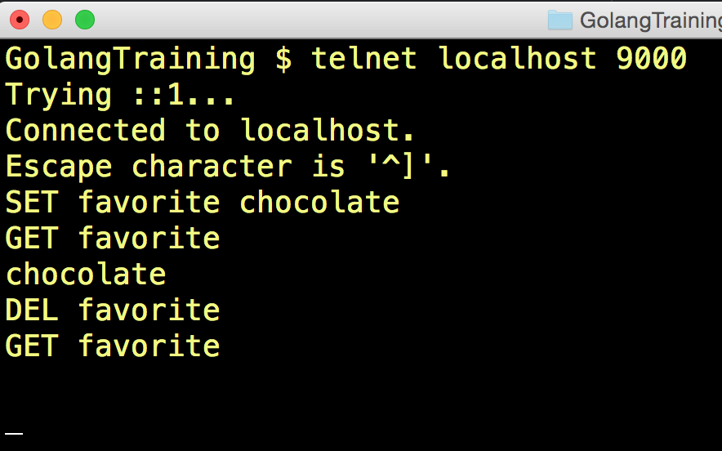

Slide 29
package strings

Slide 30
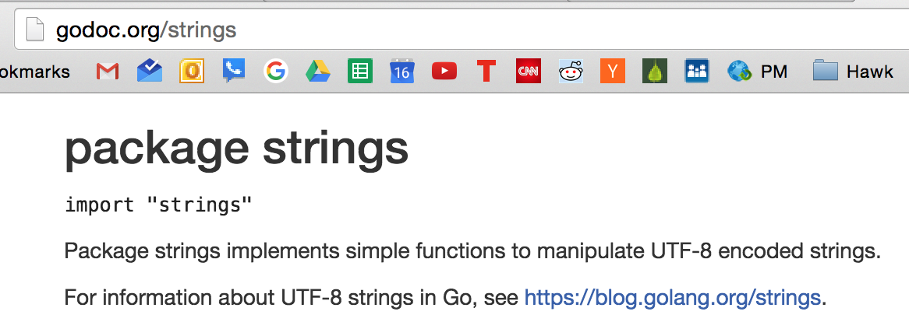

Slide 32
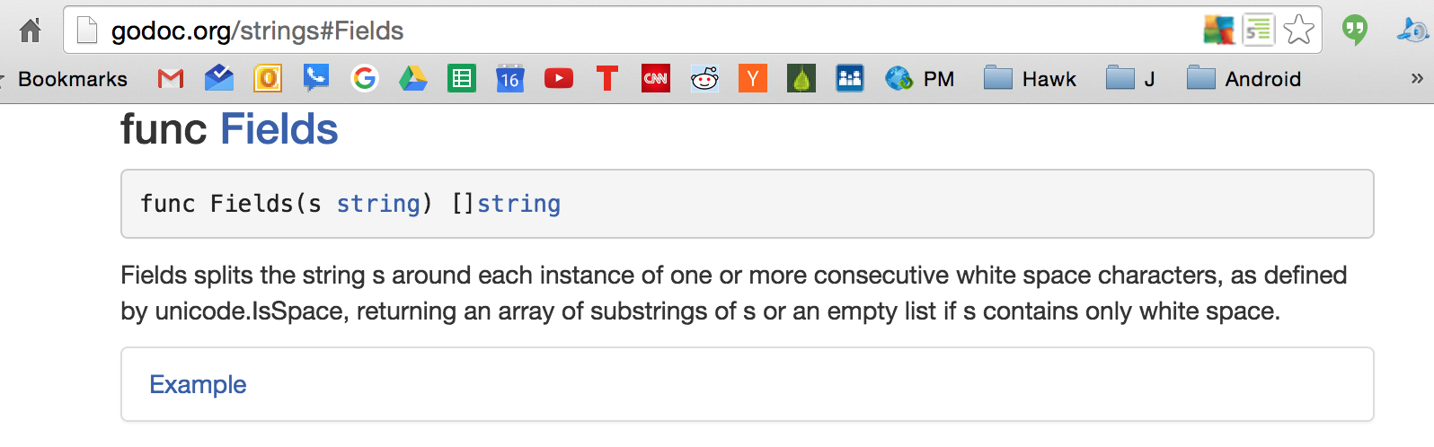

Slide 33
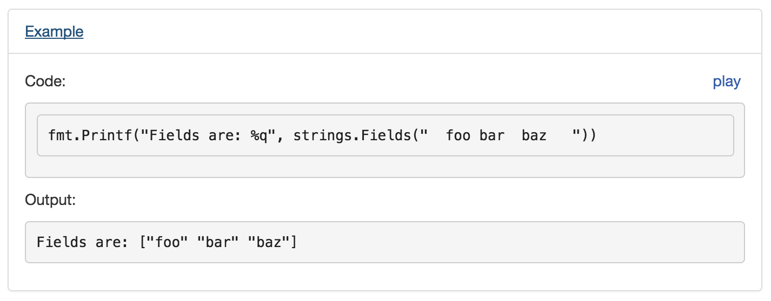

Slide 34
Continuing with this example …

Slide 35
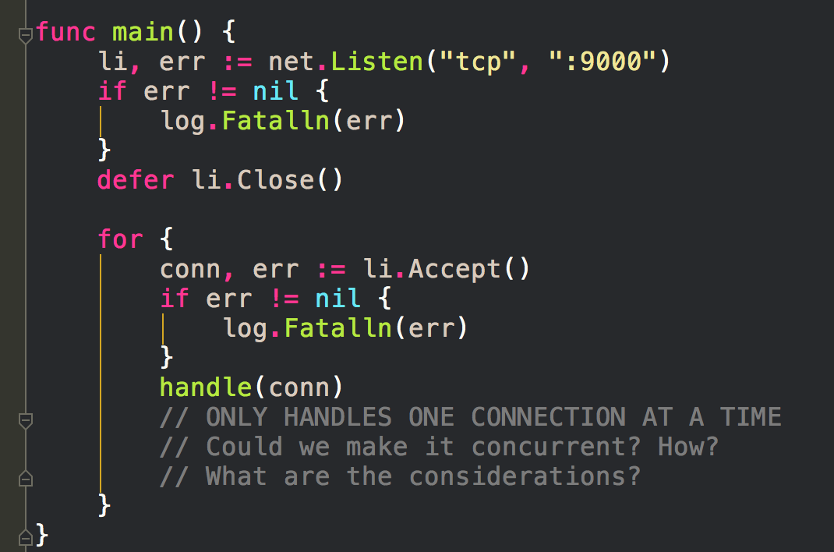
Here is our func main
which calls handle

Slide 36
atomicity, mutexes, concurrency

Slide 37
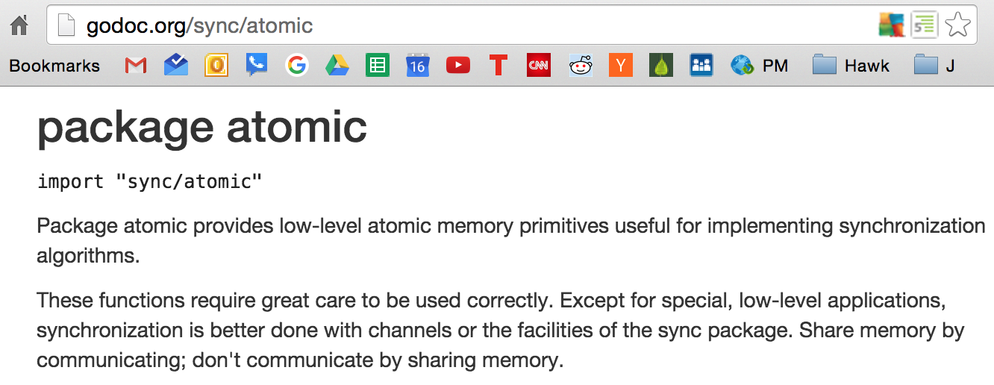

Slide 38
https://github.com/ArdanStudios/gotraining/search?utf8=%E2%9C%93&q=atomic

Slide 39
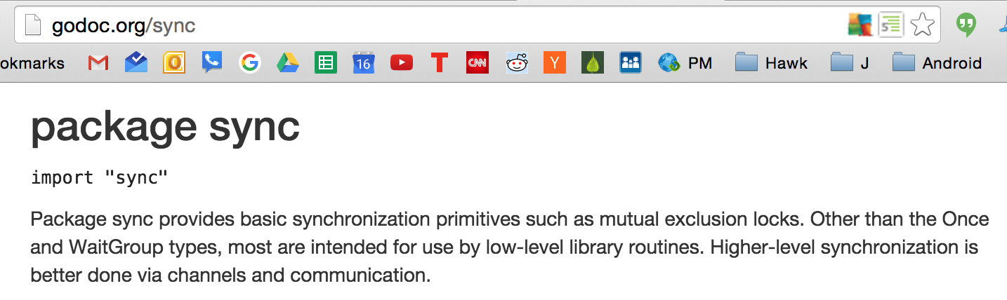

Slide 40
https://github.com/ArdanStudios/gotraining/search?utf8=%E2%9C%93&q=mutex

Slide 41
concurrency vs parallelism

Slide 42
concurrency and parallelism
“Concurrency is the composition of independently executing processes, while parallelism is the simultaneous execution of (possibly related) computations. Concurrency is about dealing with lots of things at once. Parallelism is about doing lots of things at once.”

Slide 43
concurrency
doing many things, but only one at a time
“multitasking”
parallelism
doing many things at the same time
A
A
B
B
C
C

Slide 44
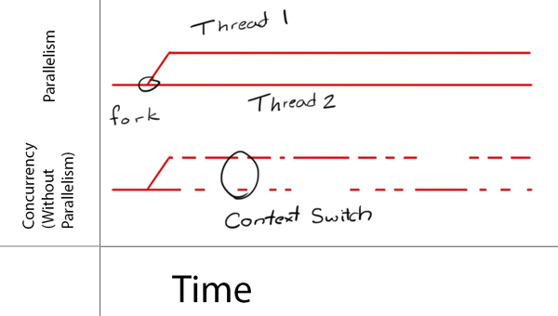
http://cdn1.raywenderlich.com/wp-content/uploads/2014/01/Concurrency_vs_Parallelism.png

Slide 45
Continuing with our example …
adding concurrency

Slide 46
Here is our func main
before concurrency

Slide 47
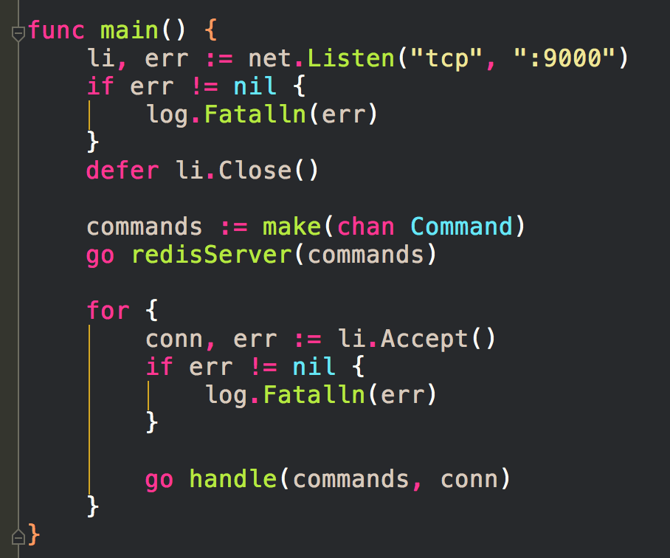
adding concurrency

Slide 48
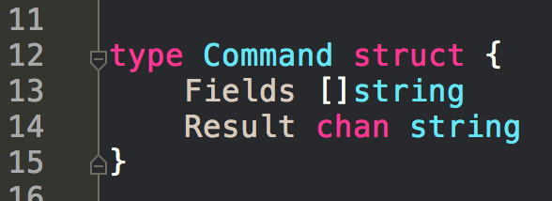
adding concurrency
https://gobyexample.com/goroutines

Slide 49
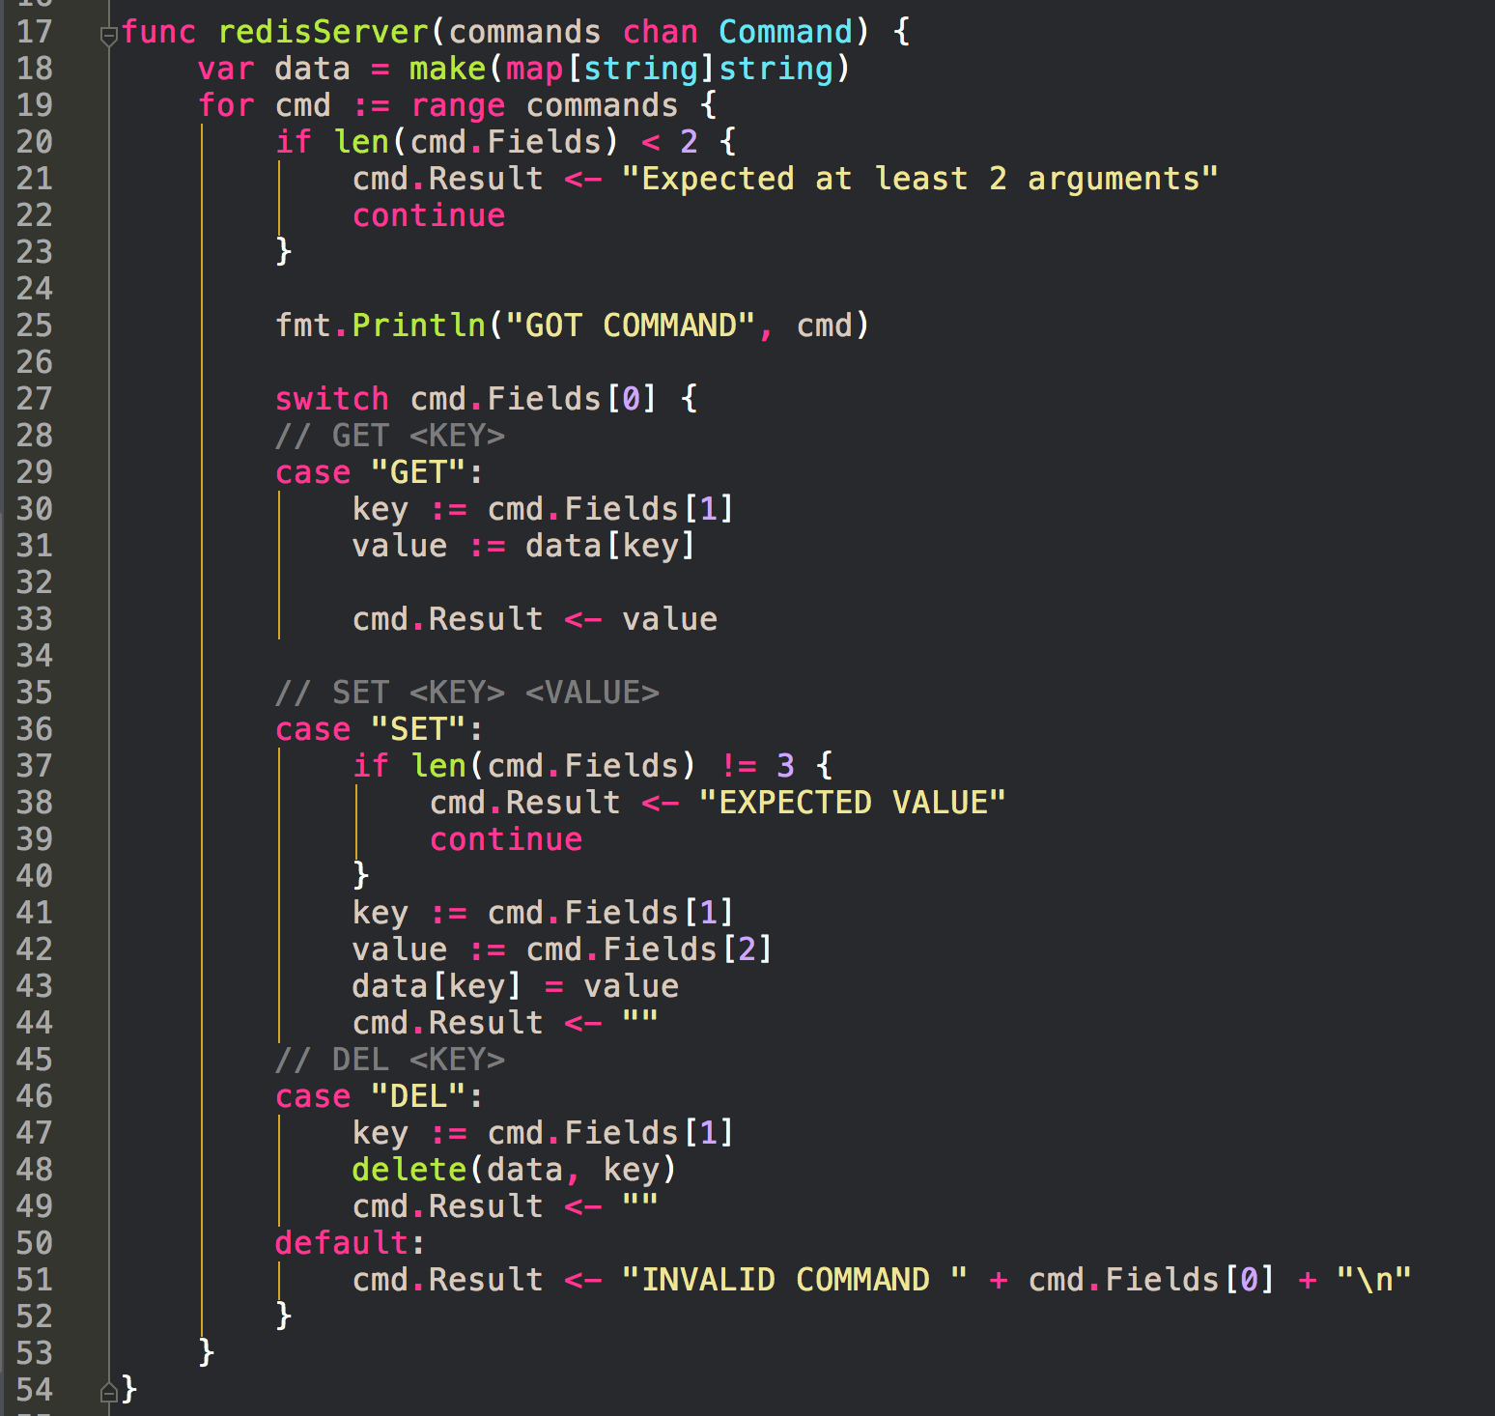
https://gobyexample.com/range-over-channels
(next slide please)

Slide 50
https://gobyexample.com/range-over-channels
https://gobyexample.com/channels
(next slide please)

Slide 51
https://gobyexample.com/range-over-channels
https://gobyexample.com/channels
(next slide please)

Slide 52
https://gobyexample.com/range-over-channels
https://gobyexample.com/channels
(next slide please)

Slide 53
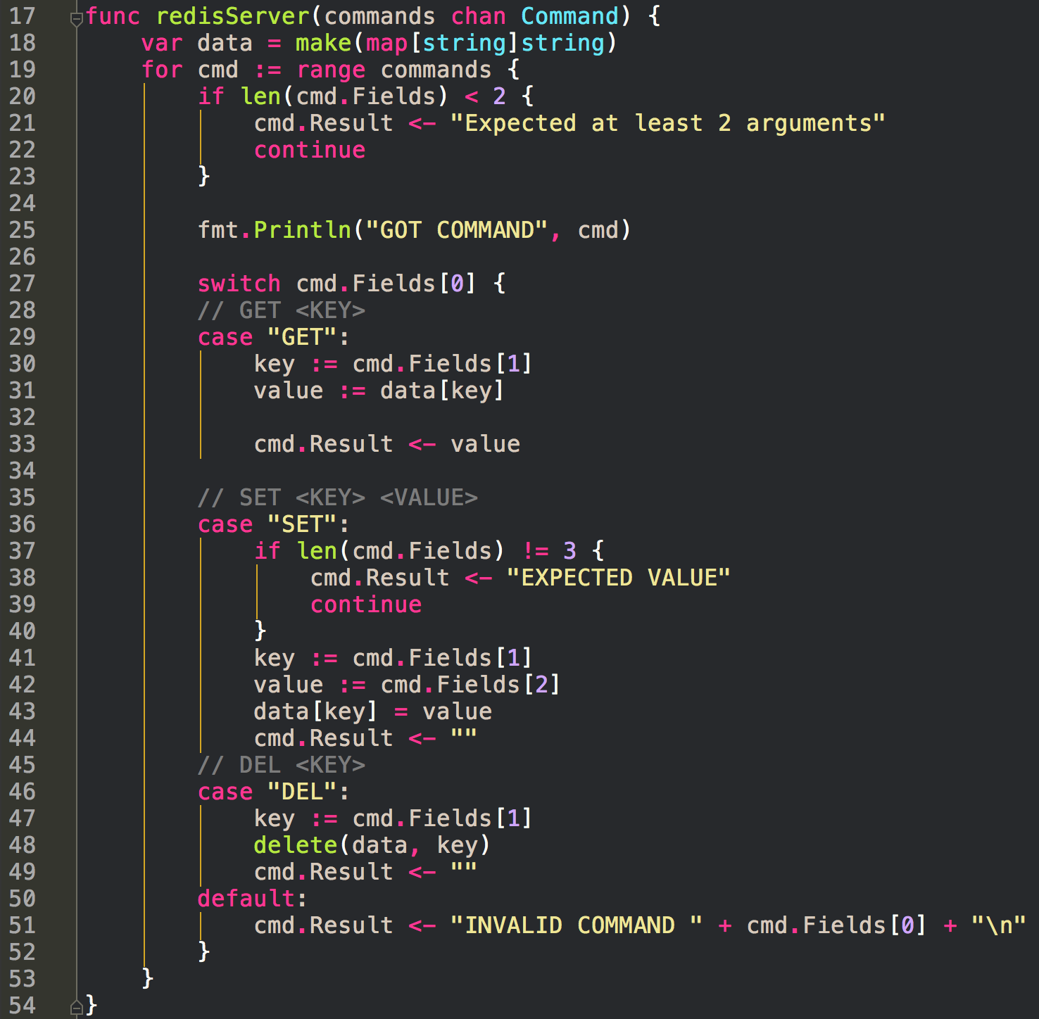
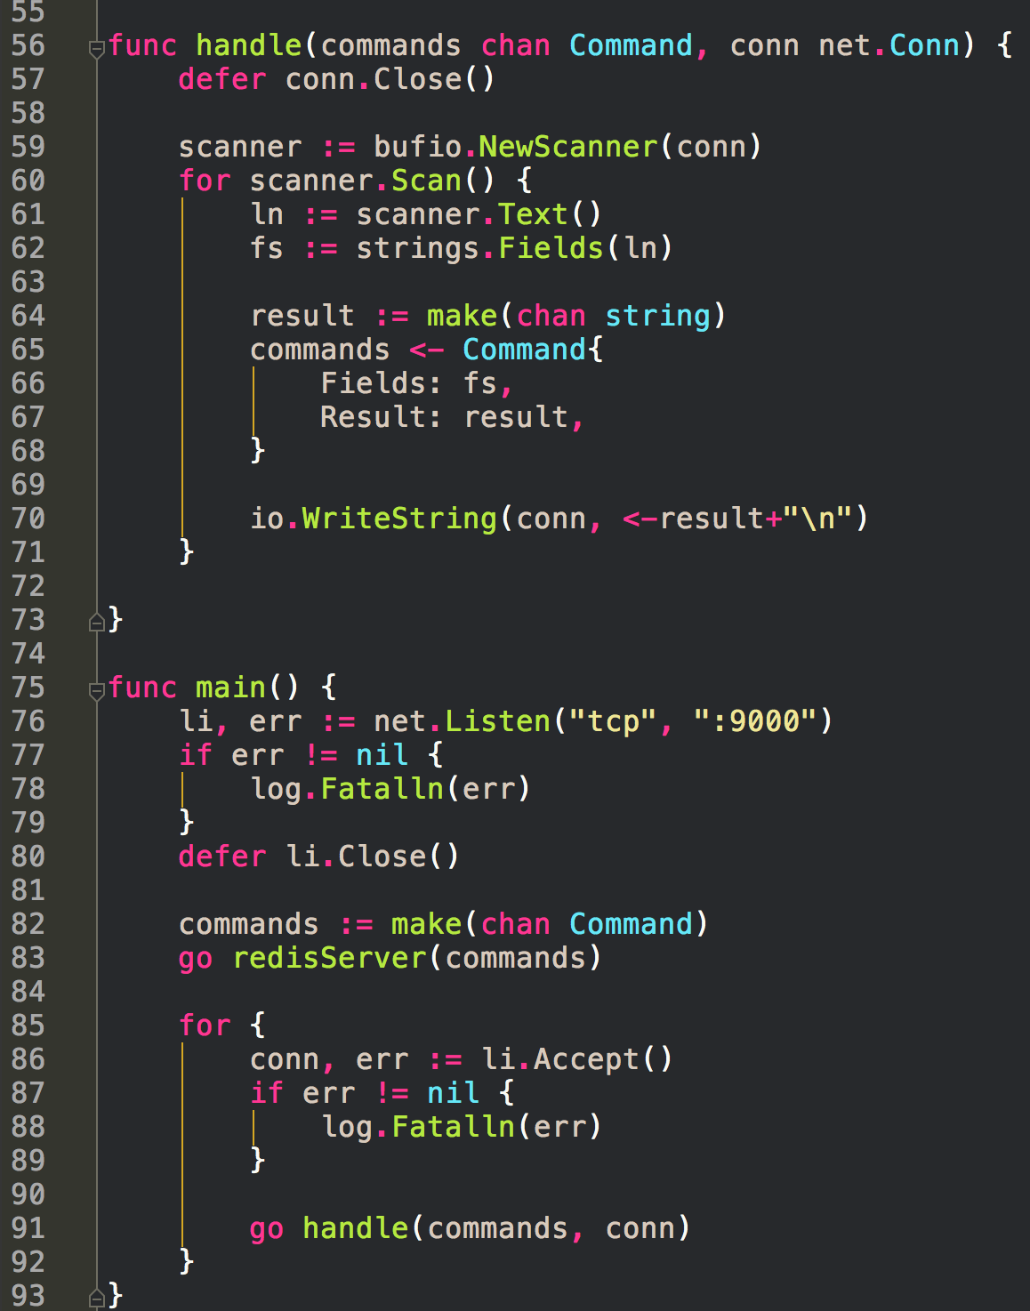
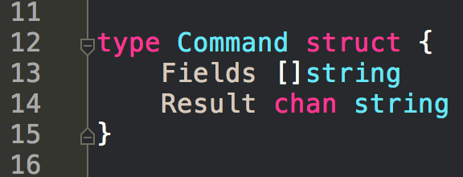
(next slide please)

Slide 54
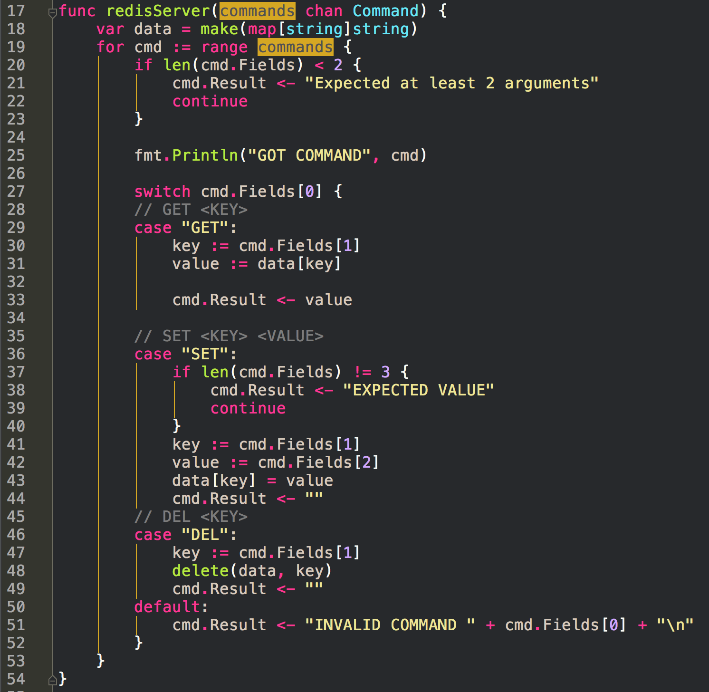
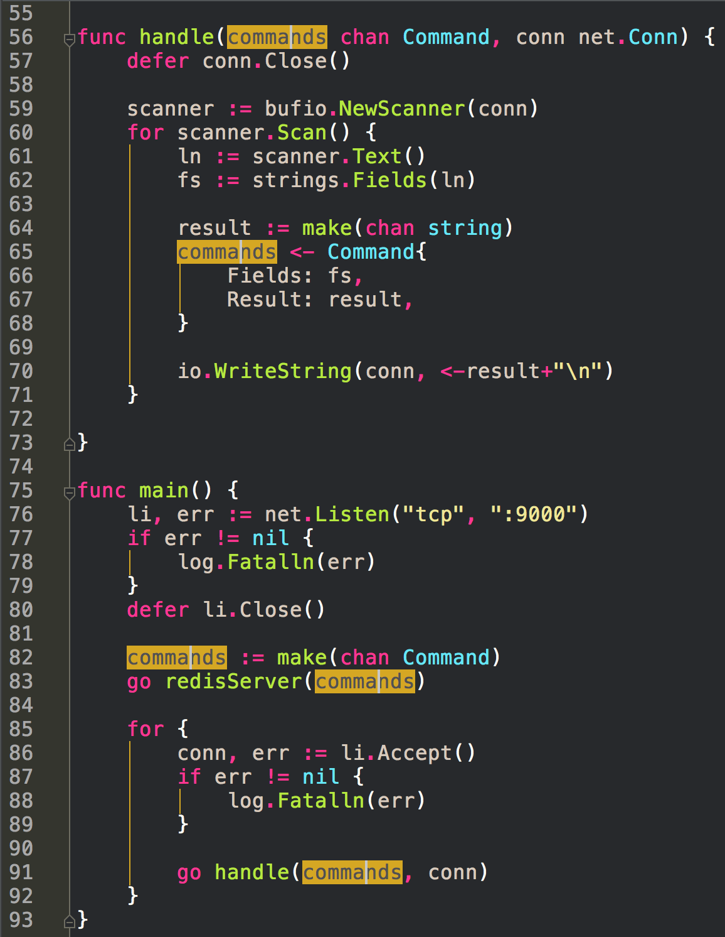
(next slide please)

Slide 55
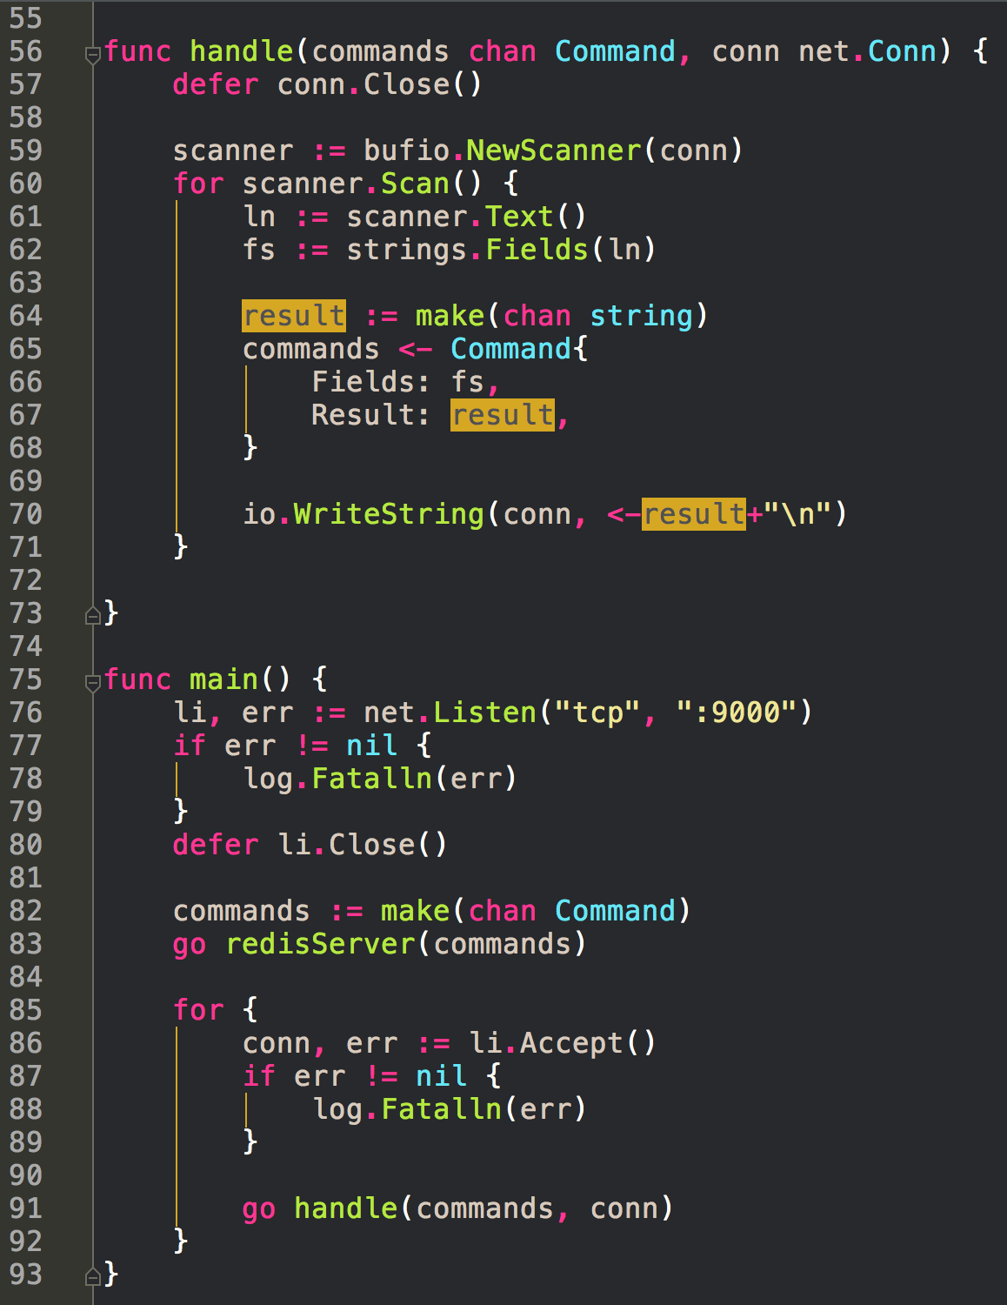

Slide 56
exercise
Do this exercise
even if you’re only retyping code
build it up step-by-step
understand each step
Create a simplified redis clone which accepts GET, SET and DEL commands. ‘GET <KEY>’ should write the value of <KEY> followed by a new line. ‘SET <KEY> <VALUE>’ should set the value of <KEY>. ‘DEL <KEY>’ should remove the value. Data should be stored in memory.

Slide 57
Caleb’s Explanation
https://www.youtube.com/watch?v=-vbhFpJMQ5w
https://www.youtube.com/watch?v=-vbhFpJMQ5w&t=18m40a

Slide 58
redis
nosql database
stored in memory
basically a map
key, value pairs
very fast
people use redis like cache
in conjunction with a sql server
load what you’re using into redis
it’s super fast

Slide 59
redis
How do you scale this?
nosql database
stored in memory
basically a map
key, value pairs
very fast
people use redis like cache
in conjunction with a sql server
load what you’re using into redis
it’s super fast

Slide 60
scaling
Vertical
more memory in one computer
Horizontal
more computers
partition your data with “hashing into buckets”
<hash %2> for two computers
<hash %10> for 10 computers
11 % 10 → store in computer 1
12 % 10 → store in computer 2
73 % 10 → store in computer 3
134 % 10 → store in computer 4
1095 % 10 → store in computer 5
….

Slide 61
redis
How do you scale this?
What happens if the power goes out?
nosql database
stored in memory
basically a map
key, value pairs
very fast
people use redis like cache
in conjunction with a sql server
load what you’re using into redis
it’s super fast

Slide 62


Slide 63


Slide 64
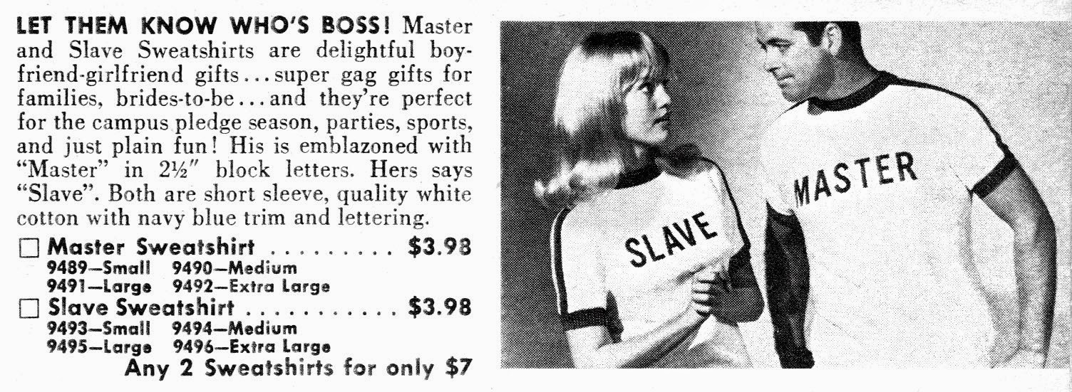

Slide 65
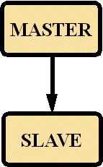

Slide 66
store identical data; “mirroring”

Slide 67
CAP Theorem
https://en.wikipedia.org/wiki/CAP_theorem

Slide 68
exercise
Modify ‘echo’ so that it returns messages as rot 13

Slide 69
optional exercise
Create a chat room server. A client can connect and send messages to the server. Those messages will be broadcast to any other currently connected clients.

